Slide 1
Sample Format and Contents for
High School
Business Model Competition
Allotted presentation time –10 minutes
5 min. for Q/A
Non proprietary information only
Note: This template is intended to provide guidance and assistance in preparing for this competition. It is not meant to be prescriptive –this is your story to tell!
Be sure to view the notes section of this presentation for hints and tips.

Slide 2
Story Time
One of the best ways to relate to a subject is through a story. This presentation is a story of your idea and what you’ve learned through customer discovery.
One way to start this presentation is by telling a short story of why you are working on this idea? Is there something meaningful that drew you to innovate in this field?
If not, tell a short story about a customer/user who is encountering the problem you are solving. Set the stage so judges can relate.

Slide 3
Positioning Statement
In 25 words or less, describe your business (not your technology, product or service)
Be very succinct.
Use only the words that are acutely important in communicating the raw business idea.
This will prepare listeners (judges) for what you will be speaking about.
Hint: Don’t spend too much time on this slide.
Notes:
After reviewing this section the judges should know:
The unique solution you are bringing to market and what value it will add to customers’ lives.

Slide 4
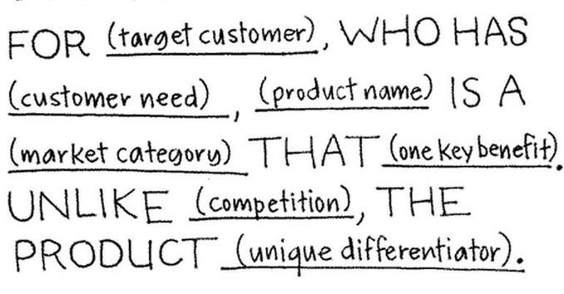
Here is one example of a positioning statement
Notes:
If SnapChat were to write a positioning statement it may look like this:
I am creating a service for youth who have a desire to express themselves on a public scale, SnapChat is a smartphone tool that captures sharable moments unlike Facebook, content shared on SnapChat is deleted by default .

Slide 5
State the Problem
Describe the problem that currently exists that your company will solve.
How big is the problem?
How many people have this problem?
Describe what you and your company would like to accomplish.
Notes:
After reviewing this section the judges should know:
Why they should be interested in your company.
Your mission to solve the problem, ie. the business concept.

Slide 6
State the Solution
Describe the Product or Service
State the solution to the problem you indicated. (Keep technical description to a minimum)
How is your product better than your competitors? (a.k.a. Value proposition ex. superior performance, better quality materials, manufacturing advantage, faster, etc.)
Notes:
After reviewing this section the judges should know:
How your solution addresses the problem
What your products/ services are
The customer needs you are fulfilling

Slide 7
Customer Discovery
What did your customer interviews reveal?
What did customers say?
What do your customers want? You could use a chart or infographic to represent responses you heard from your interviews.
How do they currently solve this problem?
How much of a pain are they feeling by not having your solution?

Slide 8
Markets
Describe your customers (market)
How many customers are out there for this solution? (the available market)
If you were to start with just a small slice of those customers, how many could you get? (addressable market)
Are there current trends likely to influence your customer/sales?
Notes:
After reviewing this section the judges should know:
Who your target customers are
The market potential
Any predictable outside influences on your market

Slide 9
Competition
Tell us about the industry you’ll be competing in.
A brief background for judges unfamiliar
Any key changes recently
Key competitors
Use a table to compare/contrast your product relative to competing products
 | My Company | Competitor #1 | Competitor #2
Value Proposition #1
Value Proposition #2
Value Proposition #3
Notes:
After reviewing this section the judges should know:
Basic information about the industry you operate in.
Who is already competing in the industry. How this problem is currently being solved in the market.
What your edge is over the competition.
How and why your products & services are competitive.

Slide 10
Business Model
Business concept –
How will your business generate money?
Subscriptions? Unit sales? E-commerce? Brick and mortar storefront?
How will you get, keep and grow your customer base?
Notes:
After reviewing this section the judges should know:
It should be clear to the judges whether you are providing a product or service
Where and from whom your company will make money
Who you are selling to
Let the judges know that you have a plan, a starting point, to get sales.

Slide 11
Financial
How much money will it take to make and sell your product? (commercialize and bring to market)
What will the cost/unit be?
What large expenses will you encounter?
Notes:
After reviewing this section the judges should:
Remember, business plans are just that, a plan (for the future). At this point, your financials are just projections.
Your company’s value is a projected valuation.
Sure, you haven’t made a penny yet, but you are projecting $_____ in the next _ years because you believe you can get ____ number of the obtainable market to purchase your solution.
We realize you won’t have all the answers, but show the judges that you are thinking about them.

Slide 12
People
Management team, their positions and relevant experience
Other key people ie. advisors, coaches, teachers
Hint: Don’t spend too much time on this slide.
Notes:
After reviewing this section the judges should know:
Who the leaders are in your business/ members of your team as well as the value they bring to the team.

Slide 13
Achievements to date
Important milestones already accomplished (if any)
X number of customer interviews
A social media following
A minimum viable product
Next steps
Notes:
After reviewing this section the judges should know:
How much time and energy you have put into this idea/invention.
If you haven’t won any awards or received any money, you may consider explaining what you plan to do next to move this business idea along.

